Slide 1
TRDI Update TCAUG Meeting May 2014

Slide 2
TRDI History
There is limited information on recycling activities in Texas & currently no comprehensive statewide information collected on the amount of material recycled in Texas.
Municipal Solid Waste Management & Resource Recovery Advisory Council (MSWRRAC passed resolution on July 22, 2011 to allow TCEQ to hold stakeholder meetings…
What recycling data can be obtained.
Determine best method for data collection.
Recommend how data could be used via Best Practices to promote recycling in Texas.
Development of a joint project steering committee with broad based representation from trade & professional organizations, COGS, industry, TCEQ, EPA Region 6, local governments, consulting firms and other interested parties.
Formation of sub-committee to conduct research and make recommendations.
Formation of TRDI – Texas Recycling Data Initiative
Formation of project Scope of Work
Hire Third Party (Leidos Engineering, LLC)
Conduct survey….
Courtesy of TRDI

Slide 3
Proposal Requirements
That it was recycled; and
That it is no longer useful or marketable, regardless of its generation point (including from residential, commercial, industrial, and agricultural activities), which might typically have been abandoned or disposed; and
That it was beneficially used regardless of its value in lieu of using virgin materials or energy sources; and
That it is quantifiable.
Courtesy of TRDI

Slide 4
Vendor responsibilities
Data Collection
Data Analysis
Maintenance of Data Confidentiality
Data Reporting
Courtesy of TRDI

Slide 5
Steering committee responsibilities
Survey process will be guided by steering committee made up of representation of trade and professional associations, and public sector organizations that will represent their industry sector.
Assist in adding and contacting additional survey targets, as needed.
Participate in quality assurance in order to identify any anomalies in data.
Final say as to release of aggregated data and/or survey results and reports.
Courtesy of TRDI

Slide 6
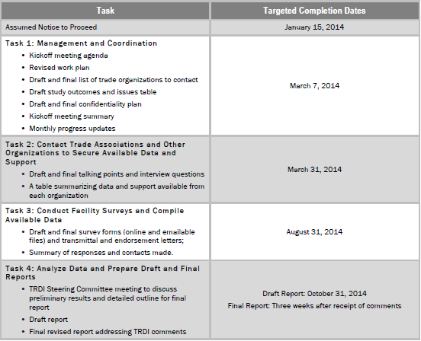
TRDI schedule
Courtesy of TRDI

Slide 7
funding
TRDI is currently seeking funding from all to support Task 2 of the project.
Contributions to date:
TXSWANA @ $ 10,350
STAR @ $ 10,350
RCOT @ $ 10,000
C&DRC @ $5,000
CTRA @ $ 2,500
Require additional $13,000
TCAUG support? Requires Vote of Membership

